Slide 1

Scaling the Dynamic Video Calling Application
Lewis Raeburn

Slide 2
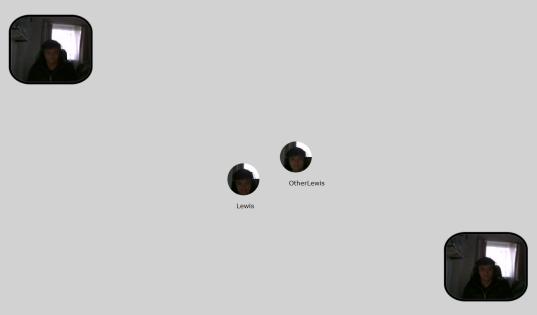
Last Year’s Work (MInf Part 1)
Implemented a WebRTC API in Links
Used the API and MVU framework to implement a (buggy) dynamic video calling application
Only 8 users can be in a video call at once before the application becomes unusable
Performance of application became worse as more users video called

Slide 3
Scaling the Application (MInf Part 2)
Application should have same, if not better, functionality but more users able to video call at once
Application should not become unusable under any circumstances

Slide 4
Approach
Test application under different circumstances with varying parameters (e.g. on a single computer vs on multiple computers, lower FPS, lower resolution, clustered video calls)
Identify the parameters and circumstances in which the application performed / scaled better and maximize use of these parameters where possible (e.g. lower FPS / resolution of users who aren’t talking)
Limit number of users who can be in a single video call at once
Also, measure CPU usage, message input / output rate, and message processing time of server processes as application runs
Optimize exchange of messages such that the number of messages sent to the server is minimized

